Slide 1
ASP.nET Core
ON Cross Platform

Slide 2
Andrew Chaa, Senior Engineer at GSA Capital
www.andrewchaa.me.uk
@andrewchaa
Born and bred in South Korea
Hired in Seoul but deployed to City of London, many years ago

Slide 3
London
Seoul

Slide 4
Why would you care?

Slide 5
Open source
On Github,
Large number of active repositories, all features of ASP.NET, middlewares, demos, and useful tools
Actively updated by contributors, Microsoft and the community

Slide 6
Modularity
Package management has been the new standard way to add functionality to applications
Pick and choose which ASP.NET features to include

Slide 7
Unified MVC and Web API
A single class to inherit: Controller
and a single interface for controller actions, IActionResult

Slide 8
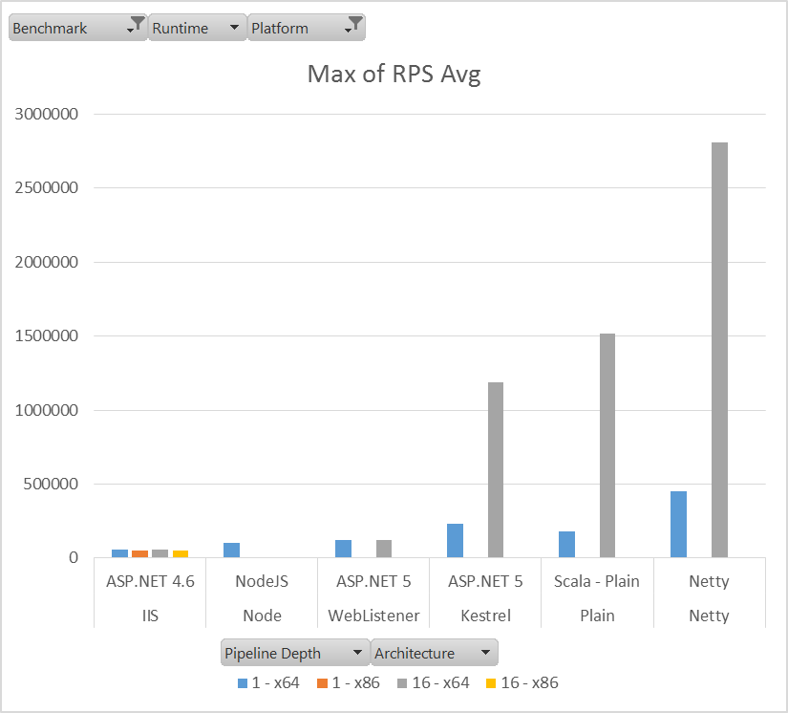
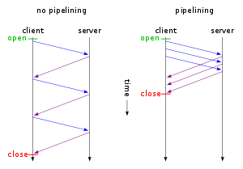
Kestrel
Plain Text with *HTTP Pipelining
(https://github.com/aspnet/benchmarks,
https://github.com/aspnet/benchmarks/blob/dev/results/Results.xlsx )
* Multiple HTTP requests are sent on a single TCP connection
without waiting for the corresponding responses

Slide 9
Cross-platform
You are not a rarity any more!
Deploy to Linux platform together with other team.
Benefit from Container

Slide 10
Do I know .NET?

Slide 11
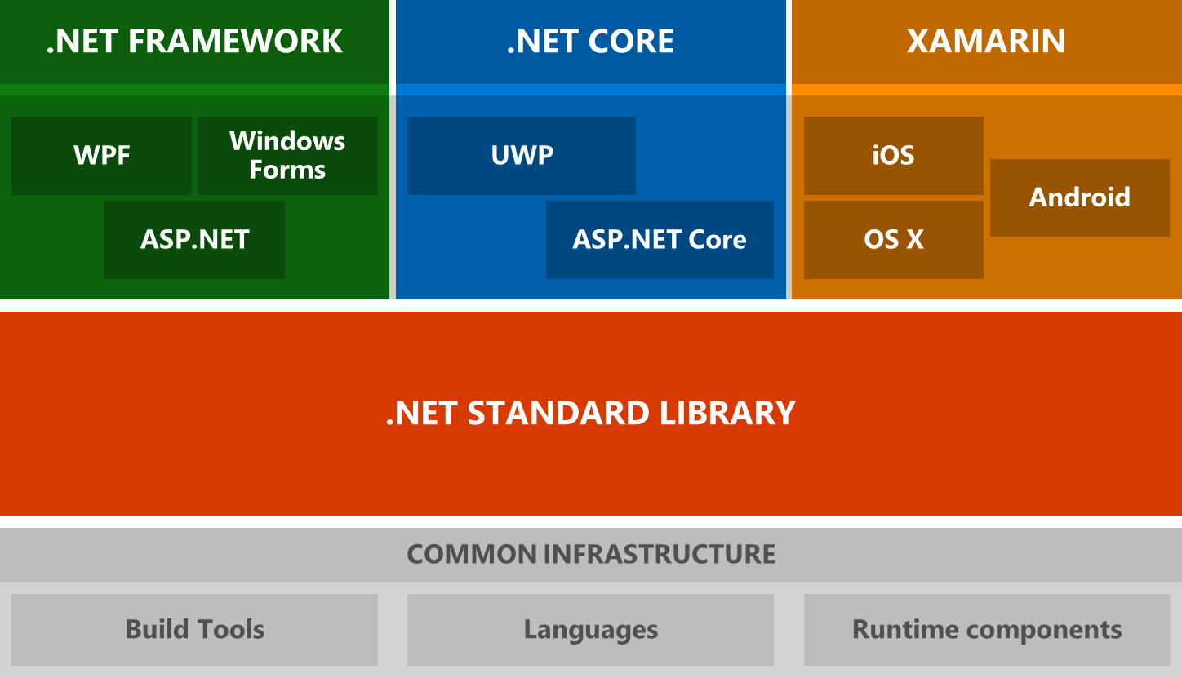
.NET Architectural Components
For more, https://docs.microsoft.com/en-us/dotnet/articles/standard/components

Slide 12
.NET Platform Support
Platform Name | Alias
.NET Standard | netstandard | 1.0 | 1.1 | 1.2 | 1.3 | 1.4 | 1.5 | 1.6 | 2.0
.NET Core | netcoreapp | → | → | → | → | → | → | 1.0 | 2.0
.NET Framework | net | → | 4.5 | 4.5.1 | 4.6 | 4.6.1 | 4.6.2 | vNext | 4.6.1
Mono/Xamarin Platforms |  | → | → | → | → | → | → | → | vNext
Universal Windows Platform | uap | → | → | → | → | 10.0 | → | → | vNext
Windows | win | → | 8.0 | 8.1
Windows Phone | wpa | → | → | 8.1
Windows Phone Silverlight | wp | 8.0
https://docs.microsoft.com/en-us/dotnet/articles/standard/library

Slide 13
Set up a Build server
Install
Hyper Term
xclip
ssh key
.NET Core 1.0.1
Mono
Docker

Slide 14
Hyper term
Install hyper term: https://hyper.is/
sudo dpkg –I hyper_1.3.1.deb
sudo apt-get install –f

Slide 15
ssh key on Ubuntu
ssh-keygen -t rsa -b 4096 -C andrew.yh.chaa@gmail.com
eval "$(ssh-agent -s)”
ssh-add ~/.ssh/id_rsa
sudo apt-get install xclip
xclip -sel clip < ~/.ssh/id_rsa.pub
For more, https://help.github.com/articles/generating-a-new-ssh-key-and-adding-it-to-the-ssh-agent/

Slide 16
Install .NET Core 1.0.1
sudo sh -c 'echo "deb [arch=amd64] https://apt-mo.trafficmanager.net/repos/dotnet-release/ xenial main" > /etc/apt/sources.list.d/dotnetdev.list'
sudo apt-key adv --keyserver hkp://keyserver.ubuntu.com:80 --recv-keys 417A0893
sudo apt-get update
sudo apt-get install dotnet-dev-1.0.1
For more, https://www.microsoft.com/net/core#linuxubuntu

Slide 17
Install MOno
sudo apt-key adv --keyserver hkp://keyserver.ubuntu.com:80 --recv-keys 3FA7E0328081BFF6A14DA29AA6A19B38D3D831EF
echo "deb http://download.mono-project.com/repo/debian wheezy main" | sudo tee /etc/apt/sources.list.d/mono-xamarin.list
sudo apt-get update
sudo apt-get install mono-devel
For more, http://www.mono-project.com/docs/getting-started/install/linux/

Slide 18
Install Docker
sudo apt-get update
sudo apt-key adv --keyserver hkp://p80.pool.sks-keyservers.net:80 --recv-keys 58118E89F3A912897C070ADBF76221572C52609D
sudo apt-add-repository 'deb https://apt.dockerproject.org/repo ubuntu-xenial main’
sudo apt-get update
apt-cache policy docker-engine
sudo apt-get install –y docker-engine
sudo systemctl status docker

Slide 19
Docker command without sudo
sudo usermod –aG docker $(whoami)
Then log out and log in back
For more, https://www.digitalocean.com/community/tutorials/how-to-install-and-use-docker-on-ubuntu-16-04

Slide 20
Often used Docker commands

Slide 21
Docker run
Run a command in a new container
docker run nginx // run nginx container image
docker run –it –p 80:80 nginx // interactively, publishing port
docker run –it –p 80:80 –v ~/Documents/Docker/nginx.conf:/etc/nginx/conf.d/default.conf nginx
// mount volume

Slide 22
Docker ps
List containers
docker ps

Slide 23
Docker Build
Build an image from a Dockerfile
docker build –t notes:0.1 .

Slide 24
docker images // list images
docker rmi 01091908 –f // remove an image
docker stop <name> // Stop a running container
docker

Slide 25
Demo
Build .NET Core app
dotnet restore
dotnet run
http://localhost:5000/api/notes

Slide 26
Demo
Note1: .NET Core
dotnet publish
cd .. /publish
cp Dockerfile
docker build –t notes1:0.1 .
Publish port
docker run –it –p 5000:5000 notes1:0.1

Slide 27
Demo
Note2: .NET Core with Mono

Slide 28
Build .NET Core app
dotnet restore
dotnet publish
dotnet run
Error: System.DllNotFoundException: System.Native
cp /usr/share/dotnet/shared/Microsoft.NETCore.App/1.0.1/System.Native.so /app/libSystem.Native.so

Slide 29
If you use VS 2017 and VS 2015 together
global.json
{
"projects": [ "src", "test" ],
"sdk": {
"version": "1.0.0-preview2-003131"
}
}

Slide 30
Build a container
docker build -t notes:0.1 .

Slide 31
Dockerfile
FROM microsoft/dotnet:1.0.1-runtime
RUN apt-key adv --keyserver hkp://keyserver.ubuntu.com:80 --recv-keys 3FA7E0328081BFF6A14DA29AA6A19B38D3D831EF \
&& echo "deb http://download.mono-project.com/repo/debian wheezy-libjpeg62-compat main" | tee -a /etc/apt/sources.list.d/mono-xamarin.list \
&& echo "deb http://download.mono-project.com/repo/debian wheezy/snapshots/4.4.2.11 main" | tee -a /etc/apt/sources.list.d/mono-xamarin.list \
&& apt-get update \
&& apt-get install -y mono-devel \
&& rm -rf /var/lib/apt/lists/*
ADD . /app
WORKDIR /app
RUN cp /usr/share/dotnet/shared/Microsoft.NETCore.App/1.0.1/System.Native.so /app/libSystem.Native.so
ENTRYPOINT ["mono", “DotNetCoreNotes.exe"]

Slide 32
Loopback address
.UseUrls("http://*:5000")
Port Publishing
docker –d –p 5000:5000 notes:0.1

Slide 33
Build a reverse proxy

Slide 34
NginX
docker pull nginx
docker run –it –p 80:80 –v ~/Documents/Docker/nginx.conf:/etc/nginx/conf.d/default.conf –name web nginx

Slide 35
Communicating between containers
docker ps
docker inspect api

Slide 36
nginx.conf
server {
listen 80;
server_name dotnetcorenotes;
location / {
proxy_set_header X-Real-IP $remote_addr;
proxy_set_header Host $host;
proxy_set_header X-Forwarded-For $proxy_add_x_forwarded_for;
proxy_pass http://172.17.0.1:5000;
}
}

Slide 37
Demo
NginX as Reverse Proxy

Slide 38
Resources
Install .NET Core on Ubuntu: https://www.microsoft.com/net/core#linuxubuntu
Publish to a Linux Production Environment https://docs.microsoft.com/en-us/aspnet/core/publishing/linuxproduction
http://blog.scottlogic.com/2016/09/05/hosting-netcore-on-linux-with-docker.html
Docker image variations: https://docs.microsoft.com/en-us/dotnet/articles/core/docker/building-net-docker-images
Mono docker: https://github.com/mono/docker/blob/f0f1e0b9f693bd7c58d9623d402c8dc69234bbe1/4.6.1.3/Dockerfile
Dot net core: https://github.com/dotnet/dotnet-docker/blob/master/1.0/debian/sdk/Dockerfile

Slide 39
Topics
Dependency.csx
The benefits of .NET Core
life on rollercoaster, catchin up with .NET Core version update
New tools in the tool box - Kestrel, NginX to Visual Studio, Powershell, and scriptcs
Setting up the local development environment
Construct testing rigs with linux and docker
Delivery Pipeline by TeamCity
Publishing and deployment
.NET Core on the cloud
Performance

